Slide 1

Email Automation Using Blue Prism
Project Supervisor: Dr.T.PREM JACOB, M.E., Ph.D.,
Name of the Student : VELLURU VARSHITH
Register Number: 39111062

Slide 2
Presentation Outline
Course Certificate
Introduction
Objectives
System Architecture / Ideation Map
Module Implementation
Application Snapshots
Results and Discussions
Conclusion & Future work
References

Slide 3
Course Certificate
Attach your Course Certificate here

Slide 4
Introduction
. Robotic process automation (RPA) is technology or software that is used to mimic the actions of a human being who is interacting with digital systems. Computer software or robots are configured to work or imitate how people interact with the systems used for business processes.
. In these days , when we wanted to send the same message through Email for many people , then it very hard to send them one-by - one. Or when a student completes a certification course then we need to send all the certificates at once through Email.

Slide 5
Objectives
project objective:
Gain insights into building blocks of blue prism automation. Importing MS Excel VBO (Visual Basic for Applications) in Blue Prism. Importing Email VBO (Visual Basic for Applications) in Blue Prism. Tuning Process Studio with specific needs. Working with different stages in the Process studio. Building a bot to automatically send mails with attachments to a list of people
scope of your project:
. If you wish to do marketing then it is necessary to send bulk of mails regarding your product to as many people as possible. Thorough this we can create a system that automatically sends the product's details through mails with a particular subject line and body of email.For this we need to store the products list needed by a particular person in the same order as stored in excel . All these prodcut list(attachment) should have a common path except the last one.We will be using Email SMTP- POP3 VOB and Excel VBO
. Achieve of The Project.:
Configure the Process Model , Import MS Excel VBO , Import Email VBO ,Process Model binding with MS Excel VBO , Process Model binding with Email VBO Adding Process Stages ,Create Instance ,Open Excel file ,Getting email IDs, Closing Excel file ,Configuring Email , Fetching attachments , Sending mails

Slide 6
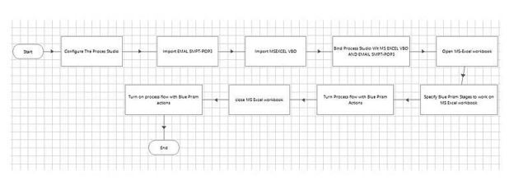
System Architecture / Ideation Map

Slide 7
Project Implementation
Hardware and Software Requirements.
The following is the Hardware required to complete this project:
i. Internet connection to download and activate
ii. Administration access to install and run Blue Prism
iii. Minimum 10GB free disk space
iv. Windows 8.1 or 10(64-bit versiononly) OR Cloud:Getstarted free,*Cloud account required
Minimum System Requirements To run Office Excel 2013,your computer needs to meet the following minimum hardware requirements
v. 500megahertz(MHz)
vi. 256 megabytes (MB) RAM
vii. 1.5 gigabytes (GB) available space
viii. 1024x768 or higher resolution monitor The following are the softwares required for the project: ix. Blue Prism software
x. Microsoft Excel2013

Slide 8
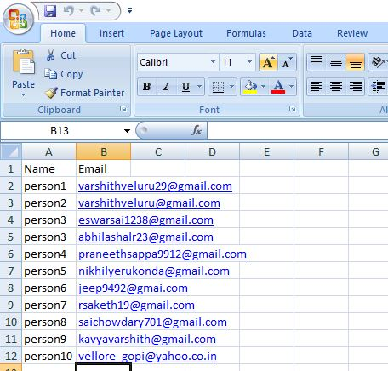
Construction.
Note: First store the name and email address of the people in Excel

Slide 9
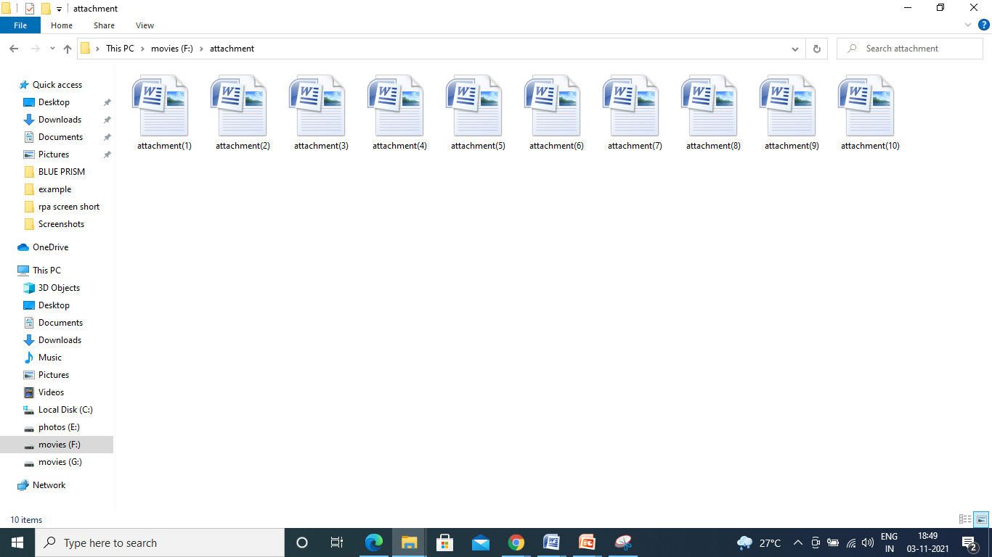
Store the attachment to add in email in a folder

Slide 10
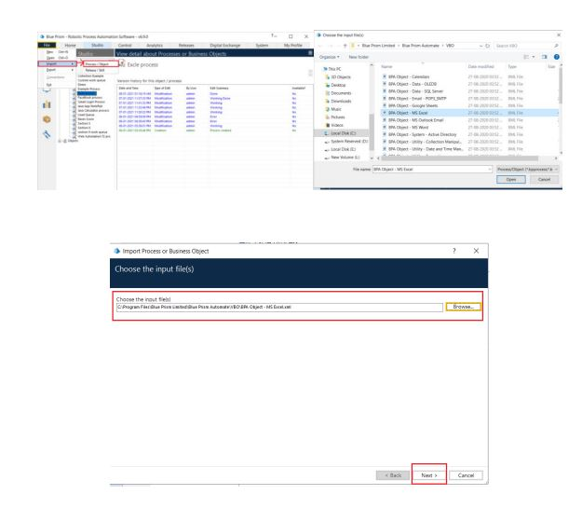
Activities 1- Importing VBOs
STEP 1:
MS Excel VBO (Import VBO file) File -> Import -> Browse -> (C:\Program Files\Blue Prism Limited\Blue Prism Automate\VBO\BPA Object - MS Excel). Click Finish.

Slide 11
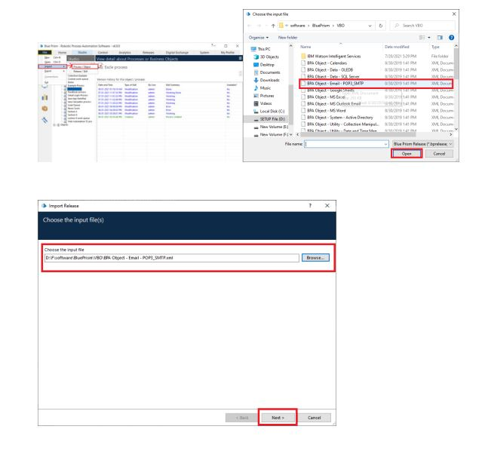
STEP 2-
Email VBO (Import VBO file) File -> Import -> Browse -> (C:\Program Files\Blue Prism Limited\Blue Prism Automate\VBO\BPA Object - Email). Click Finish.

Slide 12
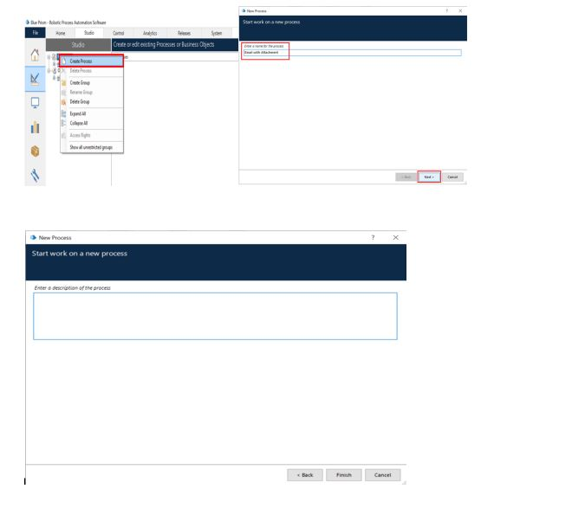
Activity-2 Configure the process
STEP 1: Create a process
After launching the Blue Prism, Open Studio tab, right-click on process, and select Create process. The screenshots clearly explain the process of creating process.

Slide 13
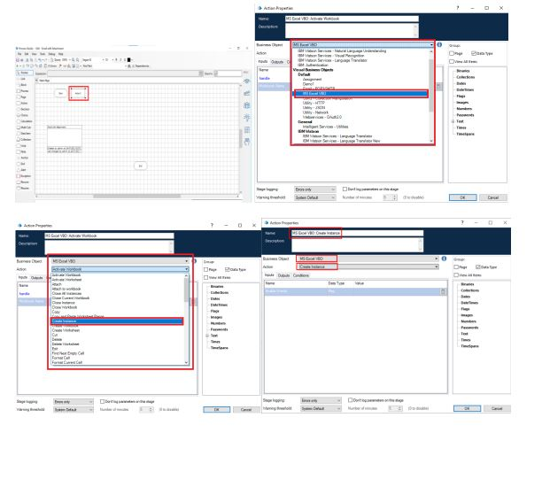
STEP 2:
Create an action stage, select MS Excel VBO from Business object drop down, select Create instance action. Create Data Item as follows,
• type = number,
• name =” handle”.
Go to output tab and drag it into Store In column, click on ok.

Slide 14
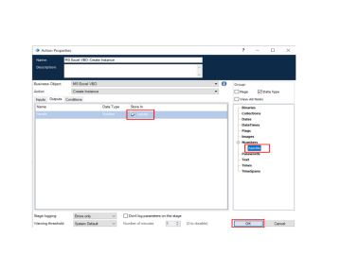

Slide 15
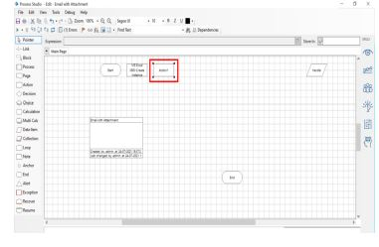
STEP 3:
Create an action stage, select MS Excel VBO from Business object drop down, select Open Workbook action. Create Data Item as follows,
• type = text; name =” Workbook name”.
Go to output tab and drag it into Workbook Name column, click on ok.
In the input tab give the handle and path of the excel file.

Slide 16
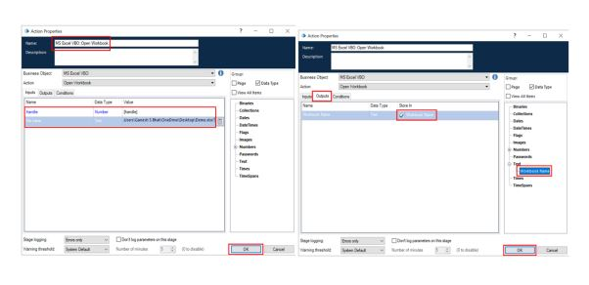

Slide 17
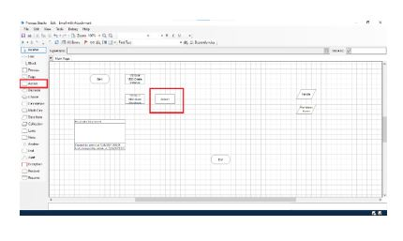
STEP-4
Create an action stage, select MS Excel VBO from Business object drop down, select Get worksheet as collection. Create Collection with fields as follows,
• type = text; name =” Name”
• type = text; name= “Email”.
Go to output tab and drag it into Workbook Name column, click on ok. In the input tab give the handle, workbook name and name of sheet in excel file.

Slide 18
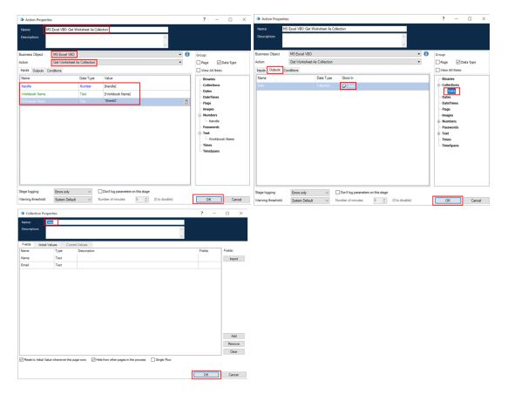

Slide 19
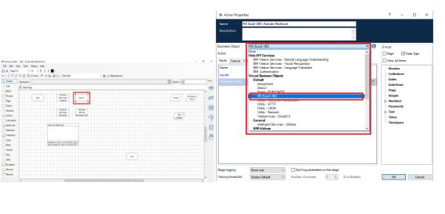
STEP-5
Create an action stage, select MS Excel VBO from Business object drop down, select Close Instance action. Drag and drop the handle, give the file name, click on ok.

Slide 20
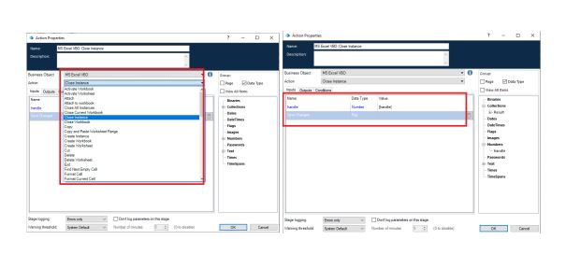

Slide 21
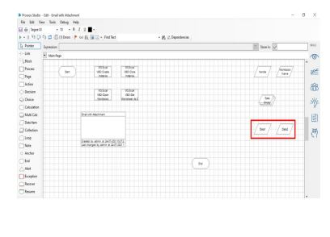
STEP-6:Add two data items
To store the Email
• Name – Email
• Type – Text
• Initial value – Your email ID
2. To store the Password
• Name - Password
• Type – Password
• Initial value – Password of your email ID

Slide 22
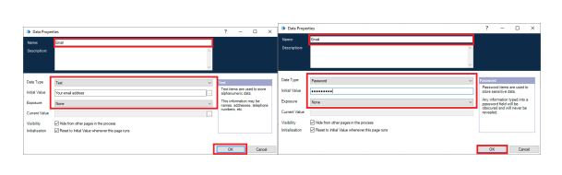

Slide 23
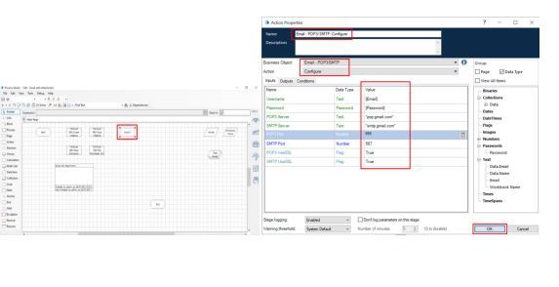
STEP-7
Create an action stage, select Email VBO from Business object drop down, select Configure action.
In the input tab give the Email and Password and the give the following details:
• POP3 Server = "pop.gmail.com"
• SMTP Server = "smtp.gmail.com"
• POP3 Port = 995
• SMTP Port = 587
• POP3 UseSSL = True
• SMTP UseSSL = True
Click on ok

Slide 24
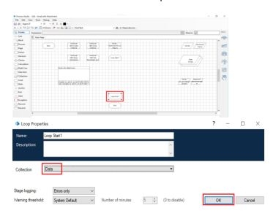
STEP-8 Add a loop stage and make it to loop for Data collection.
Drag and drop a loop stage and change the arrangement of all the stages in the page, double click on it and in the collection drop down select data collection

Slide 25
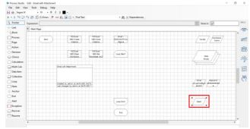
STEP-9 Add two data items
1.To store the path of the attachment (only the constant path. For the numerical part we will be using calculation stage.
• Name – Path
• Type – Text
• Initial value – constant values in the attachment path.
2. To store the number to increment the path for each attachment
• Name – Count
• Type – Number
• Initial value – 1

Slide 26
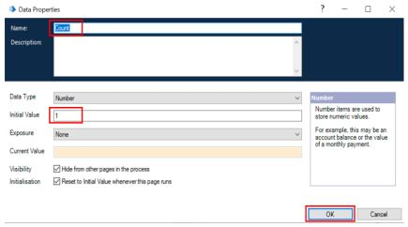
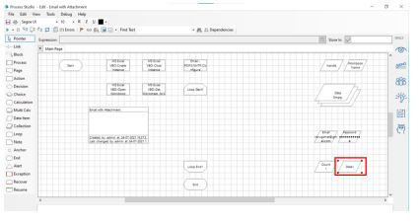

Slide 27
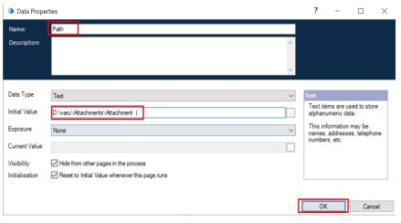

Slide 28
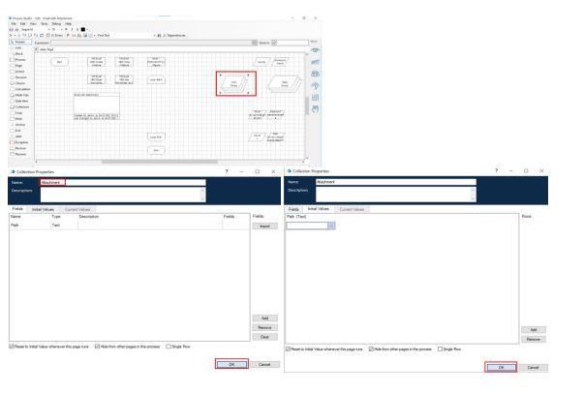
STEP-10 Add a multi calculation stage to store the path to Attachment collection and to calculate path.
Drag and drop a multi calculation stage, double click on it and add the following:
• Calculate the path and store it in Attachment collection.
• Increment count.

Slide 29
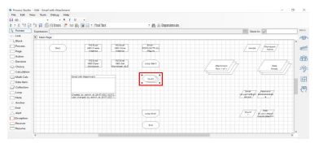
STEP-11 : Add a multi calculation stage to store the path to Attachment collection and to calculate path.
Drag and drop a multi calculation stage, double click on it and add the following:
• Calculate the path and store it in Attachment collection.
• Increment count

Slide 30
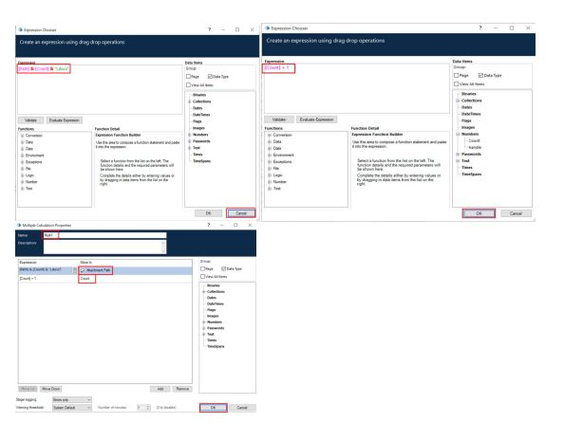

Slide 31
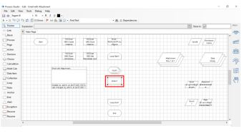
STEP 12 :Create an action stage, select Email VBO from Business object drop down, select Send message action.
In the input tab give the following details:
• From = Email data item
• To = Email from data collection
• Subject = The subject you want to send
• Body = The body you want to send
• Attachment = Attachment collection
Click on ok

Slide 32
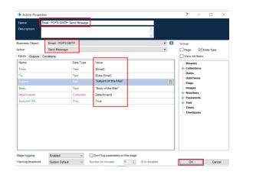

Slide 33
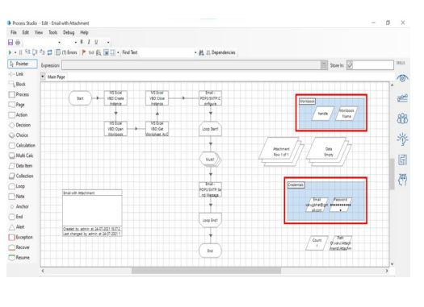
STEP 13: Link all the stages and run the bot at different timings to notice getting login to different classes.
Do Proper connections (Links).

Slide 34
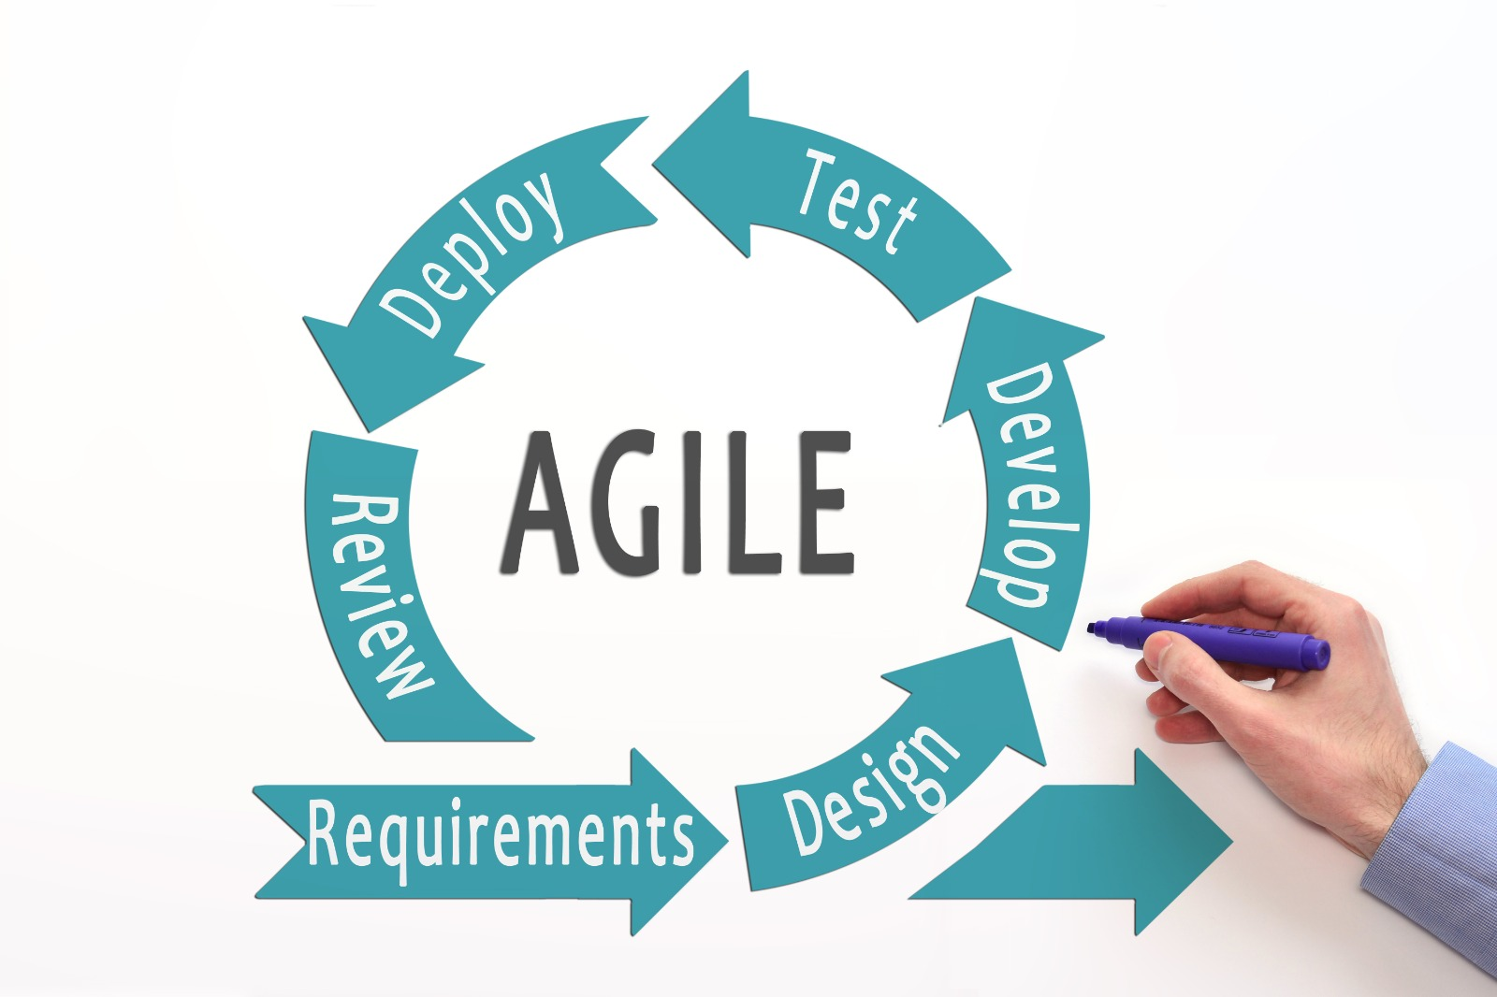
Methodology

Slide 35
REQURIMENTS:
We need to launch blue prism software is one of the technology of RPA. We need to have
MS-EXCEL SHEET
PC WITH 64 BIT
DESIGN:
We need to import MS-EXCEL VBO and EMAIL SMTP Tuning process studio with specific needs To build a bot. That automatically send messages
DEVELOP:
In this stage we need to develop the process studio with different stages that are required
○ Create Instance
○ Open Excel file
○ Getting email IDs
○ Closing Excel file
○ Configuring Email
○ Fetching attachments
○ Sending mails

Slide 36
TEST:
After completion of develop stage we need to run the process and test the output. If we need any update in the output or any correction just we can go to develop stage and we
Can change the stages .
DEPLOY:
In this stage we will update and change the stages in the development so that we can get the correct output according to the users.
REVIEW:
The entire project has to be reviewed and get feedback from the people who are using this.
Finally we have to launch the project.

Slide 37
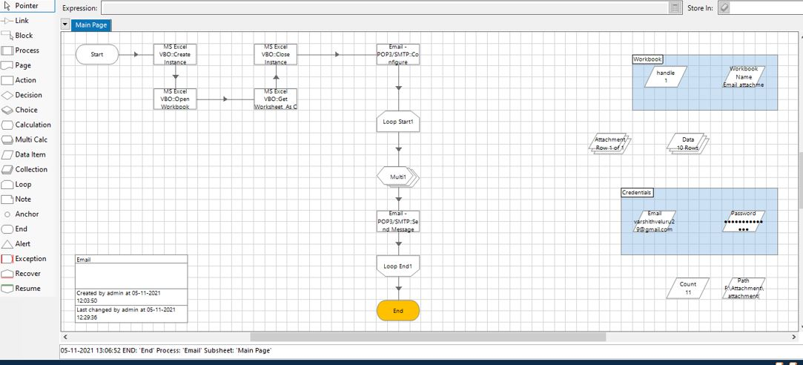
Results and Discussion

Slide 38
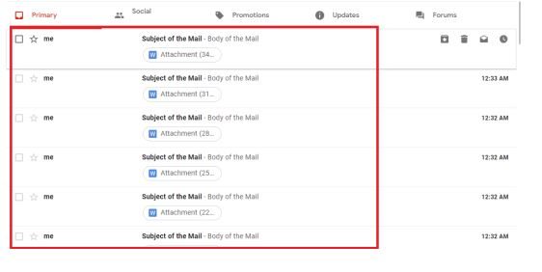
The Above Picture Shows. That we have successfully sent Email with the attachment To the list of people where attached in the Excel sheet.
Email automation is now a digital marketing staple, replacing the tedious task of manually sending emails to every customer with preconfigured workflows. You can specify what communication should be triggered in response to each customer’s behavior. This lets you map a variety of customer journeys and ensure optimum engagement with your brand.

Slide 39
Conclusion
On doing this project we got to know that email automation is very important for our further development . At first we have to store the each person email id in Microsoft Excel and save it for later use Then we have to import MS-EXCEL VBO and Email SMTP-POP3 VOB into the Blue Prism , then create the process and then we have to give the following actions such as create instance , opening excel file , getting email id's , closing the excel file , Configuring Email, fetching the attachments and then sending the mails. Click on refresh button then click run button to run the program.Then the resultant output will be emails sent with the attachment

Slide 40
Better personalisation for prospects
When an email is automatically sent in personalized email workﬂows,it'll have personalisation tokens that are ﬁlled with the contact's information such as name,location,the company they work for,...etc
This adds a further relationship strengthening between a prospect and your business.
Reduce the potential for errors
If you currently have one person writing and sending emails to new leads,then there is a high chance that a mistake can happen.Getting somebody's name worng is a mistake.
Making spelling mistakes or hitting send prematurely can cause the email recipient to have less trustin your company.It shows lack of intrest and attention to detail but with email workﬂows, they can be proofed and checked over and over before you send them.
Reduce costs
You don't need a large sales team making cold calls everyday.They can approach people when they're ready and you don't need additional admin teams ensuring eamils are sent out regularly.Paying for a large team to constantly contact prospects isn't needed.
Also you don't need a tech savvy to use marketing automation.

Slide 41
References
[1] M. Lacity, L. P. Willcocks, & A. Craig.Robotic process automation at Telefonica
O2.The Outsourcing Unit Working Research Paper Series, 2015
[2] IRPA, “Introduction To Robotic Process Automation,” tech. rep., 2015.
[3] H. P. Fung "Criteria, use cases and effects of information technology process automation (ITPA)." Advances in Robotics & Automation 3 (2014).
[4] Dana Nau, Malik Ghallab, and Paolo Traverso Automated Planning: Theory & Practice. Morgan Kaufmann, 2014.
[5] M. Barrett, E. Oborn, W. J. Orlikowski, and J. Yates, “Reconfiguring 4Relations: Robotic Innovations in Pharmacy Work ,” Organ. Sci., vol. 23, pp. 1448– 1466, 2012.

